Slide 1
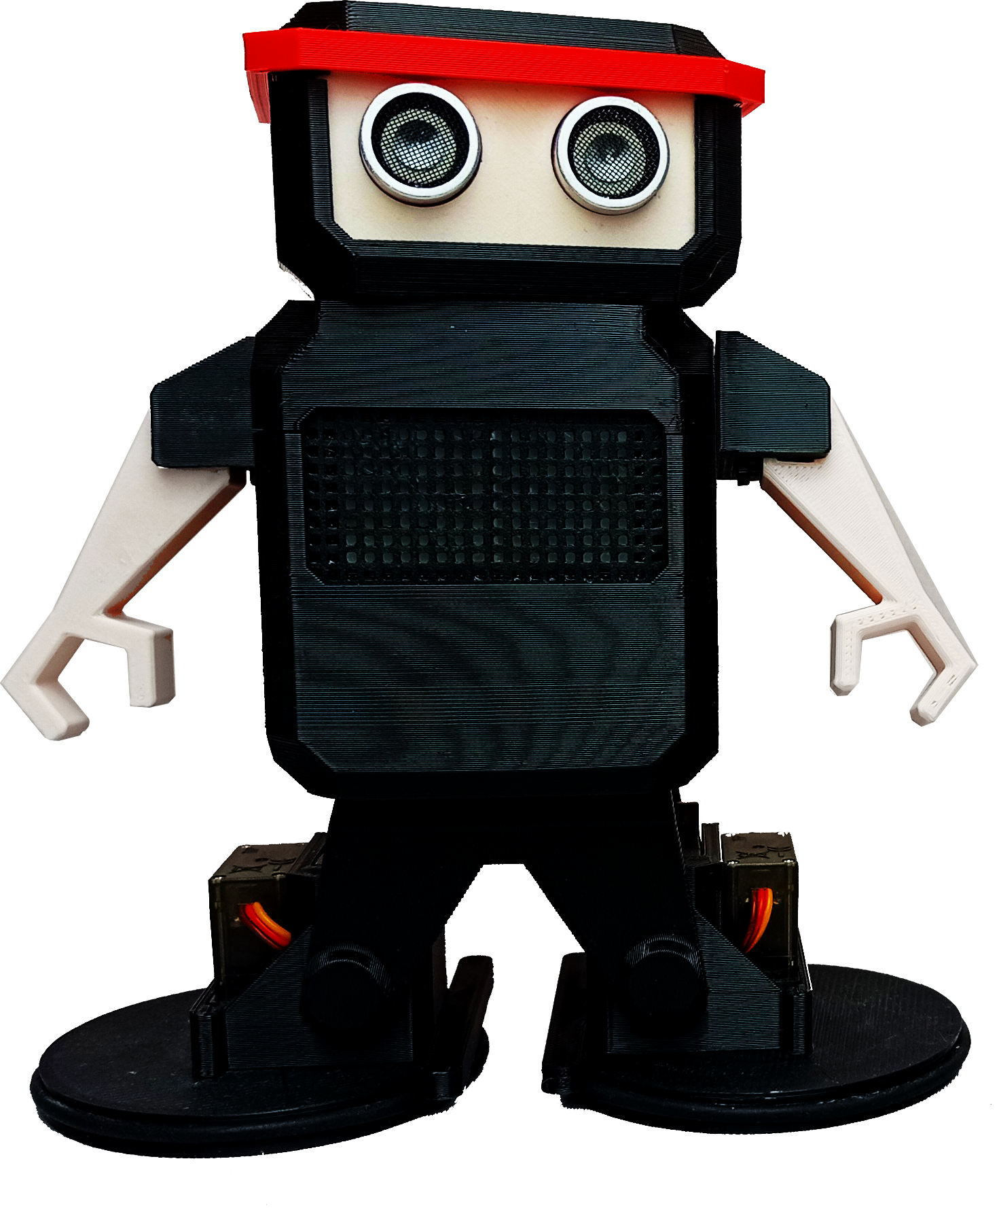
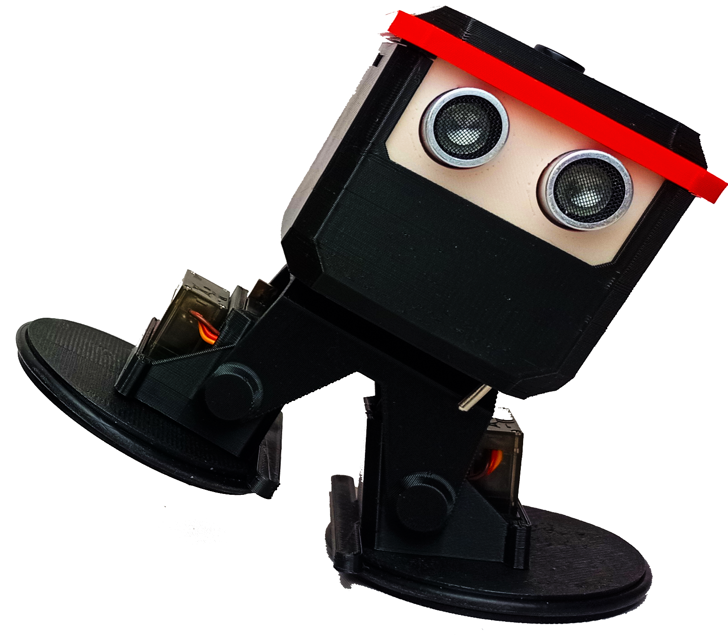
Otto Ninja!
101

Slide 2
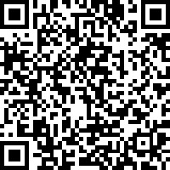
Building
For assembly instructions, please visit this link:
3D instructions Online
or scan the QR code on the right

Slide 3
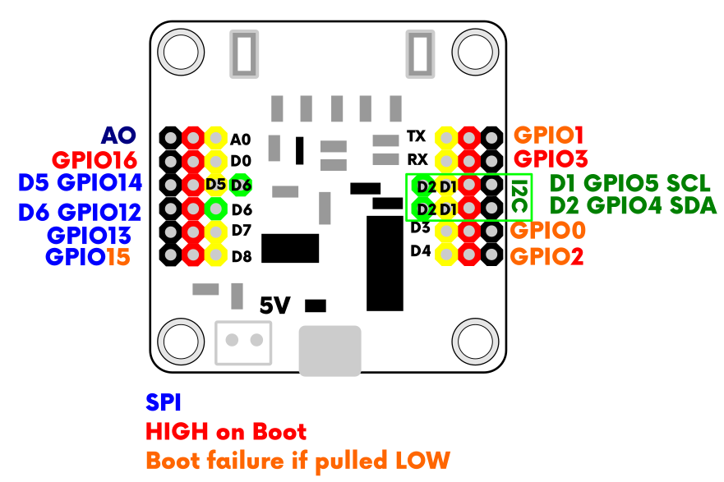
Ninja PCB board
Ninja robot PCB programming board
Microcontroller programmable board, based on the ESP8266 chip.
This is the brain of a new generation of DIY robots, thanks to its compact size, with integrated Wi-Fi for communication and control.

Slide 4
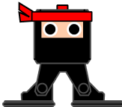
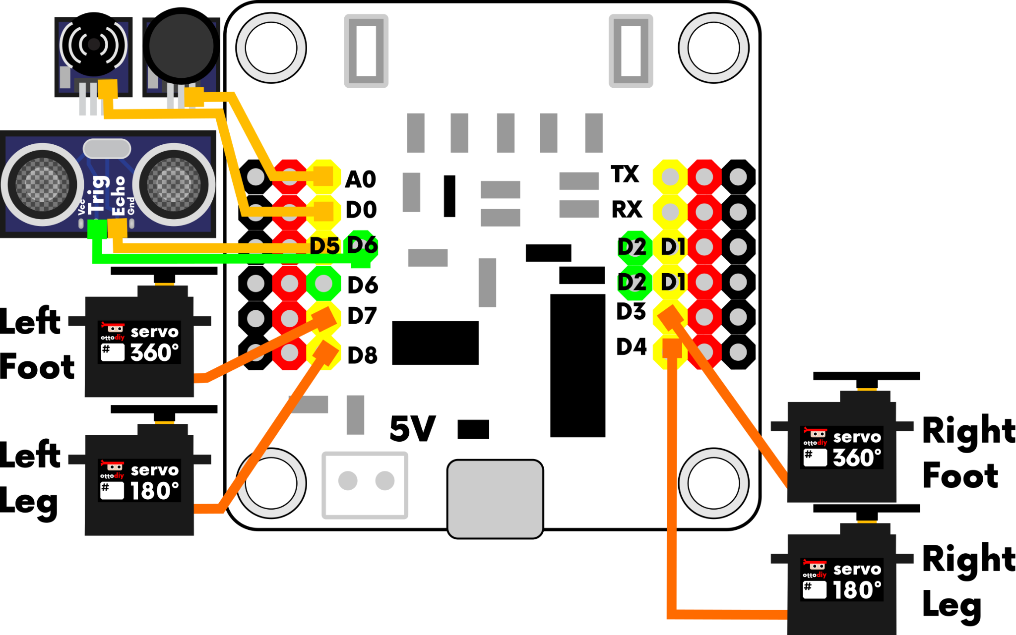
Wiring for Starter
Here is how you can connect the components to the Ninja main circuit board (brain)
Left Leg to D8 Servo 180º
Right Leg to D4 Servo 180º
Left Foot to D7 Servo 360º
Right Foot to D3 Servo 360º
NO NEED TO CONNECT BUZZER OR BUTTON OR ULTRASOUND FOR APP

Slide 5
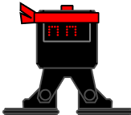
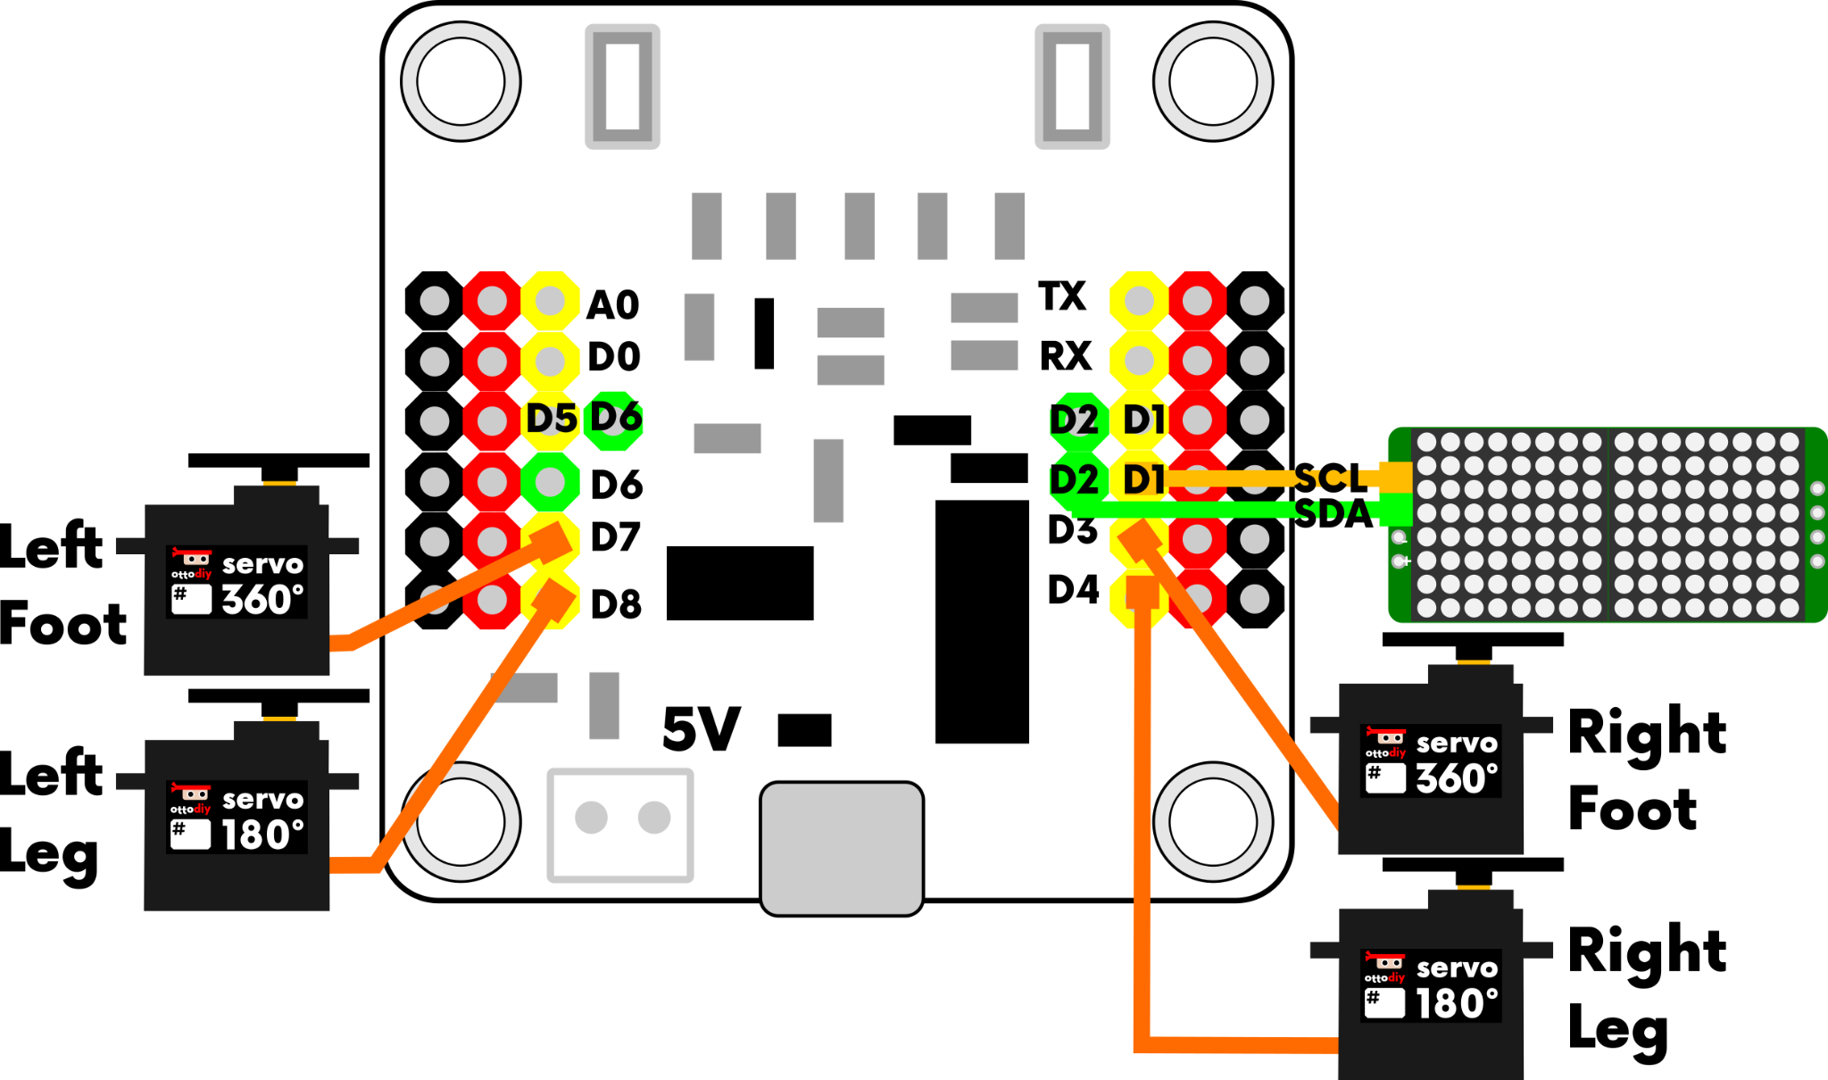
Wiring for Starter
Depending on how you want your ninja to look, you can swap components like our 16x8 LED Matrix display instead of the ultrasound sensor
LED Matrix SCL pin to D1
LED Matrix SDA pin to D2

Slide 6
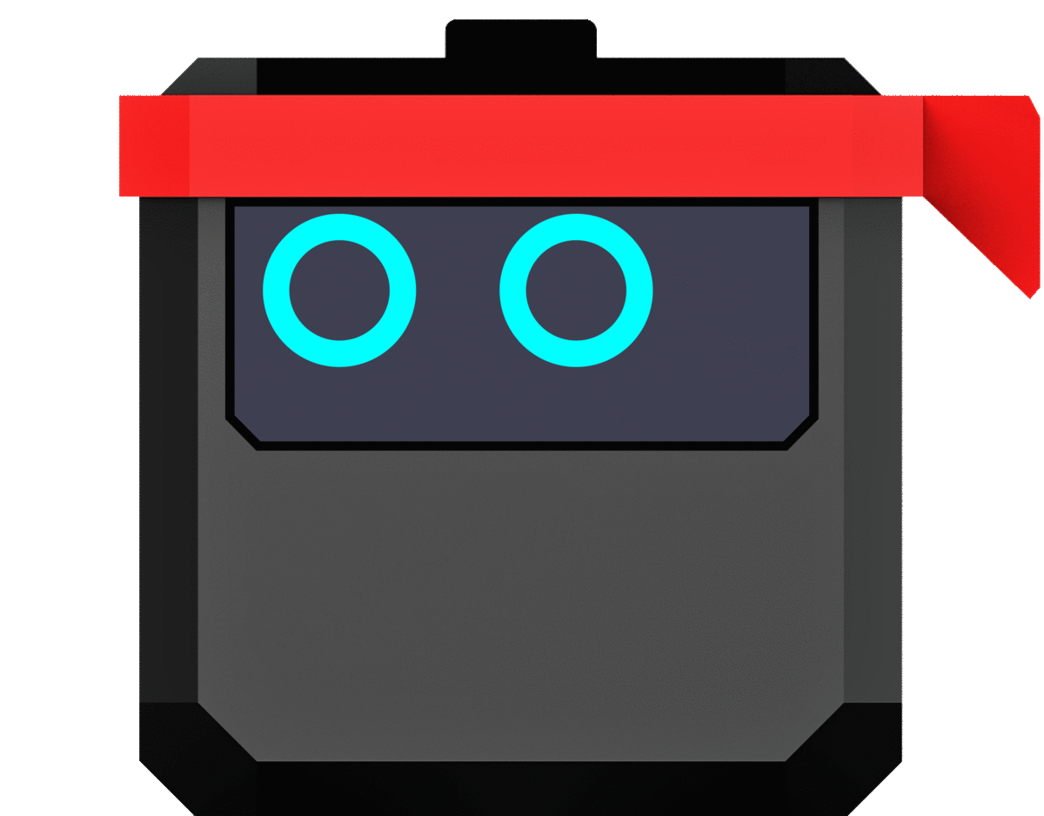
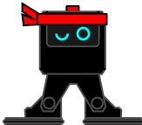
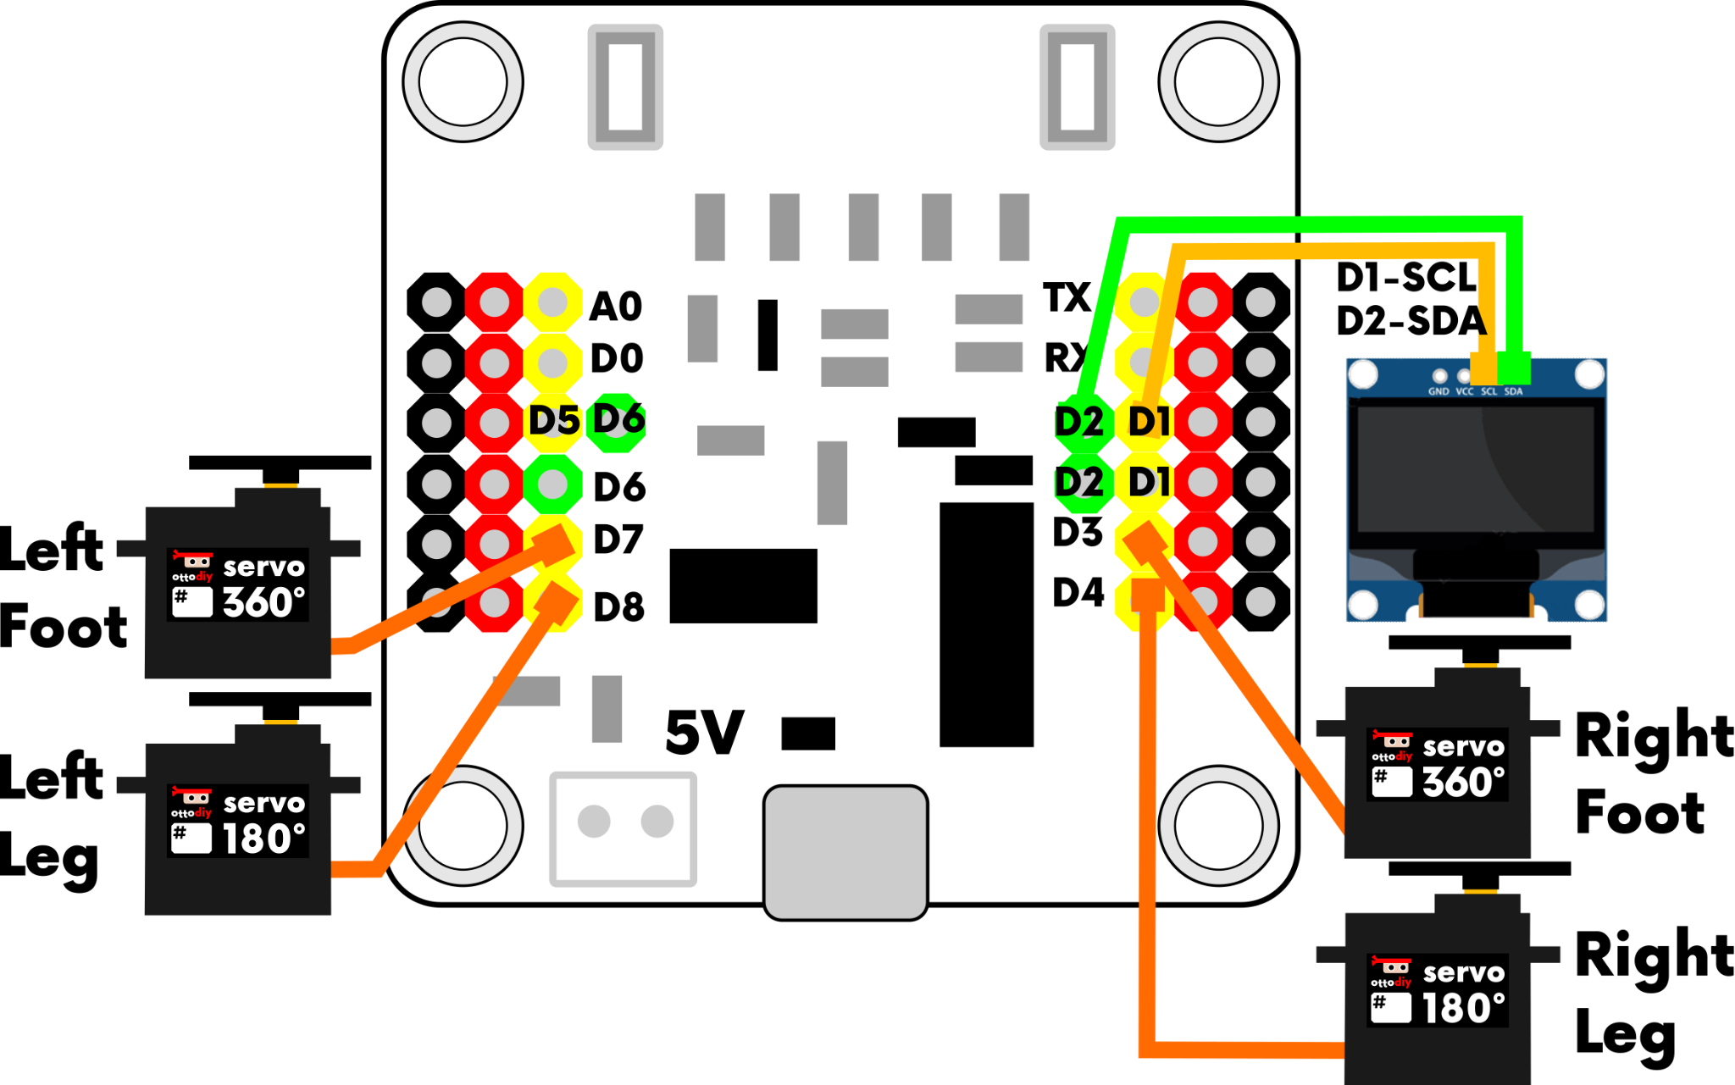
Wiring for Starter
The double I2C ports allow you to connect endless type of sensors and displays, you could even connect 2 at the same time if needed.
OLED display SCL pin to D1
OLED display SDA pin to D2

Slide 7
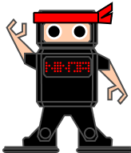
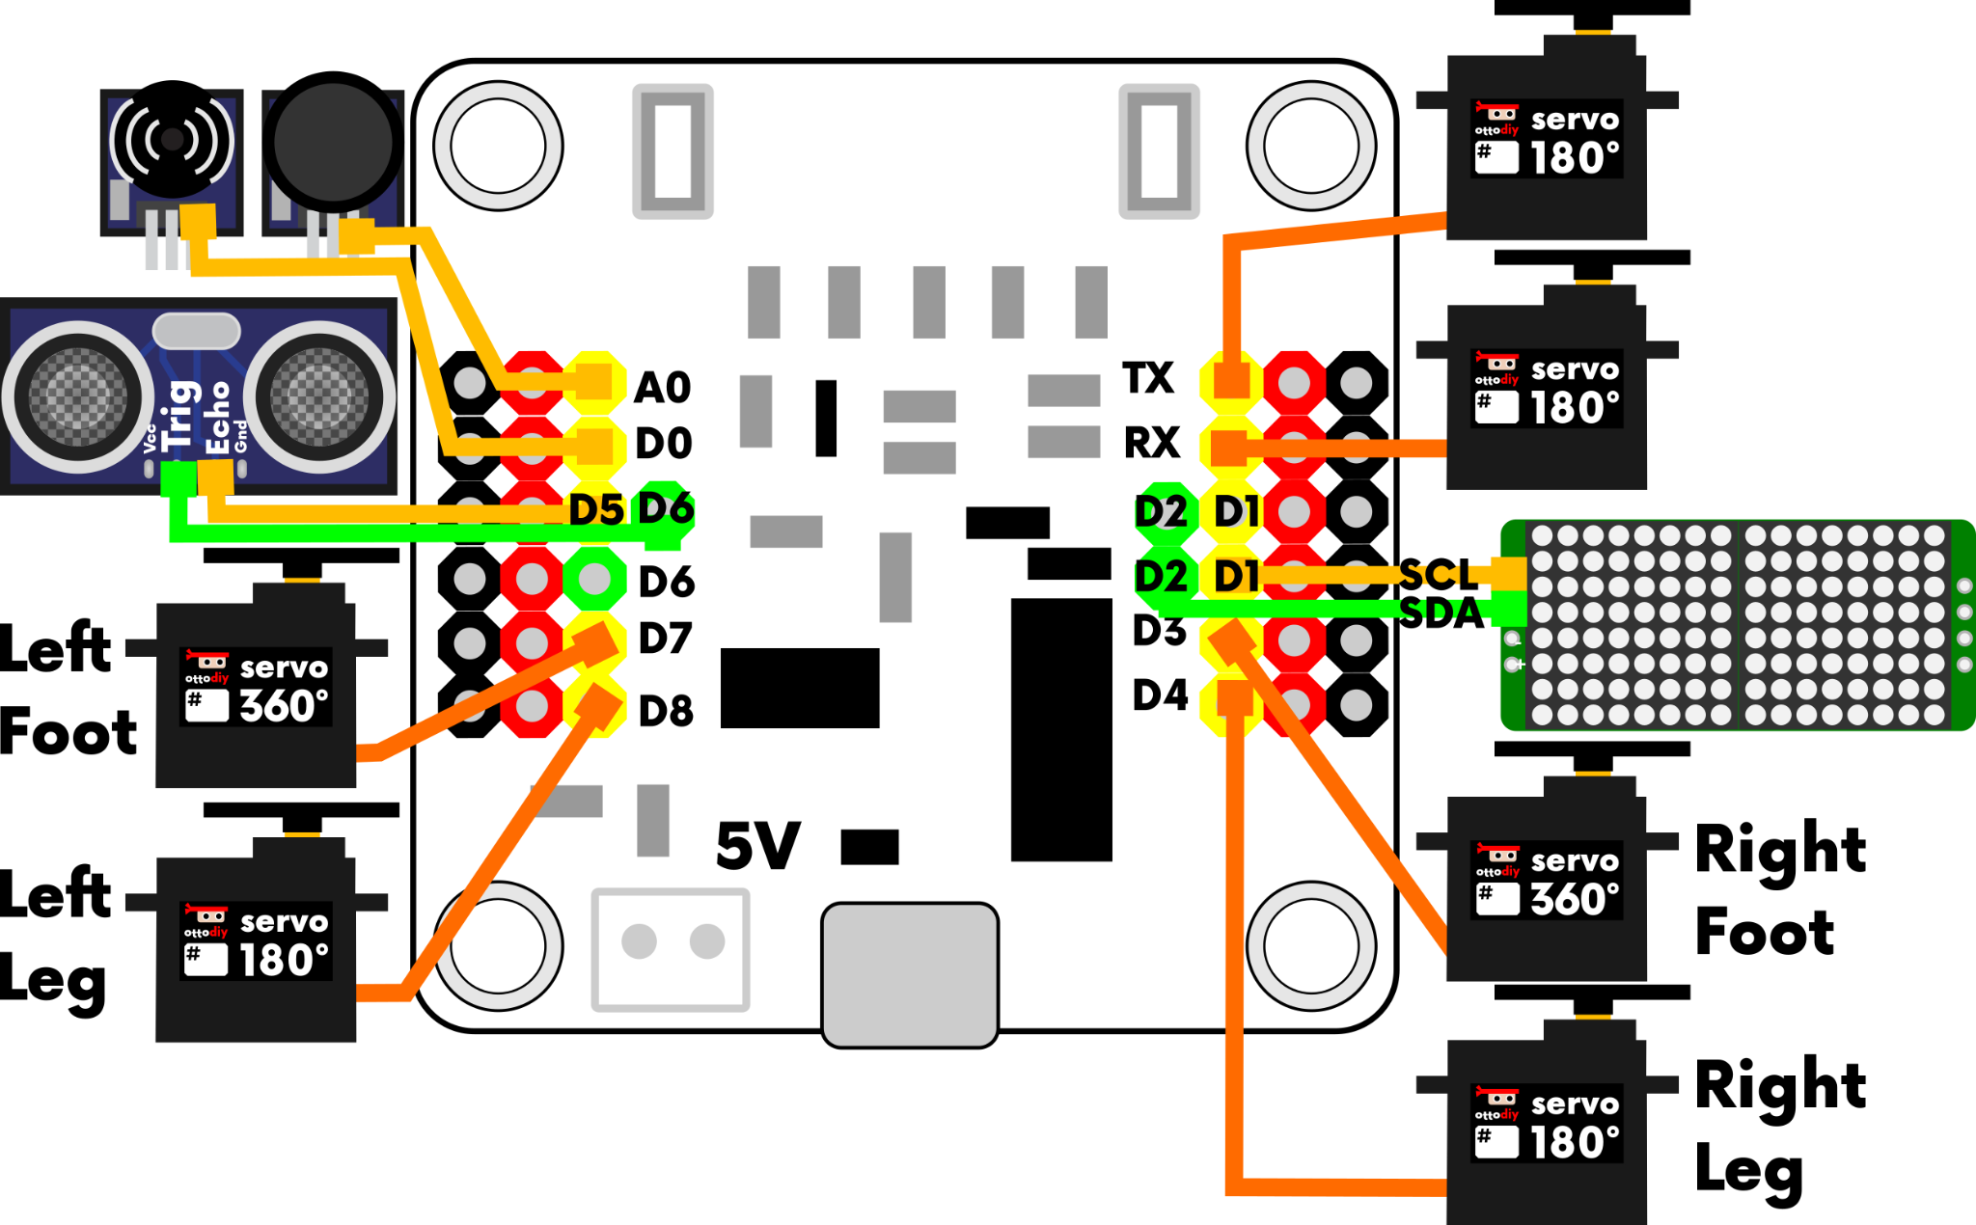
Wiring for Humanoid
Legs and Feet same as starter
Left Arm to TX Servo 180º
Right Arm to RX Servo 180º
LED Matrix SCL pin to D1
LED Matrix SDA pin to D2

Slide 8
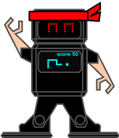
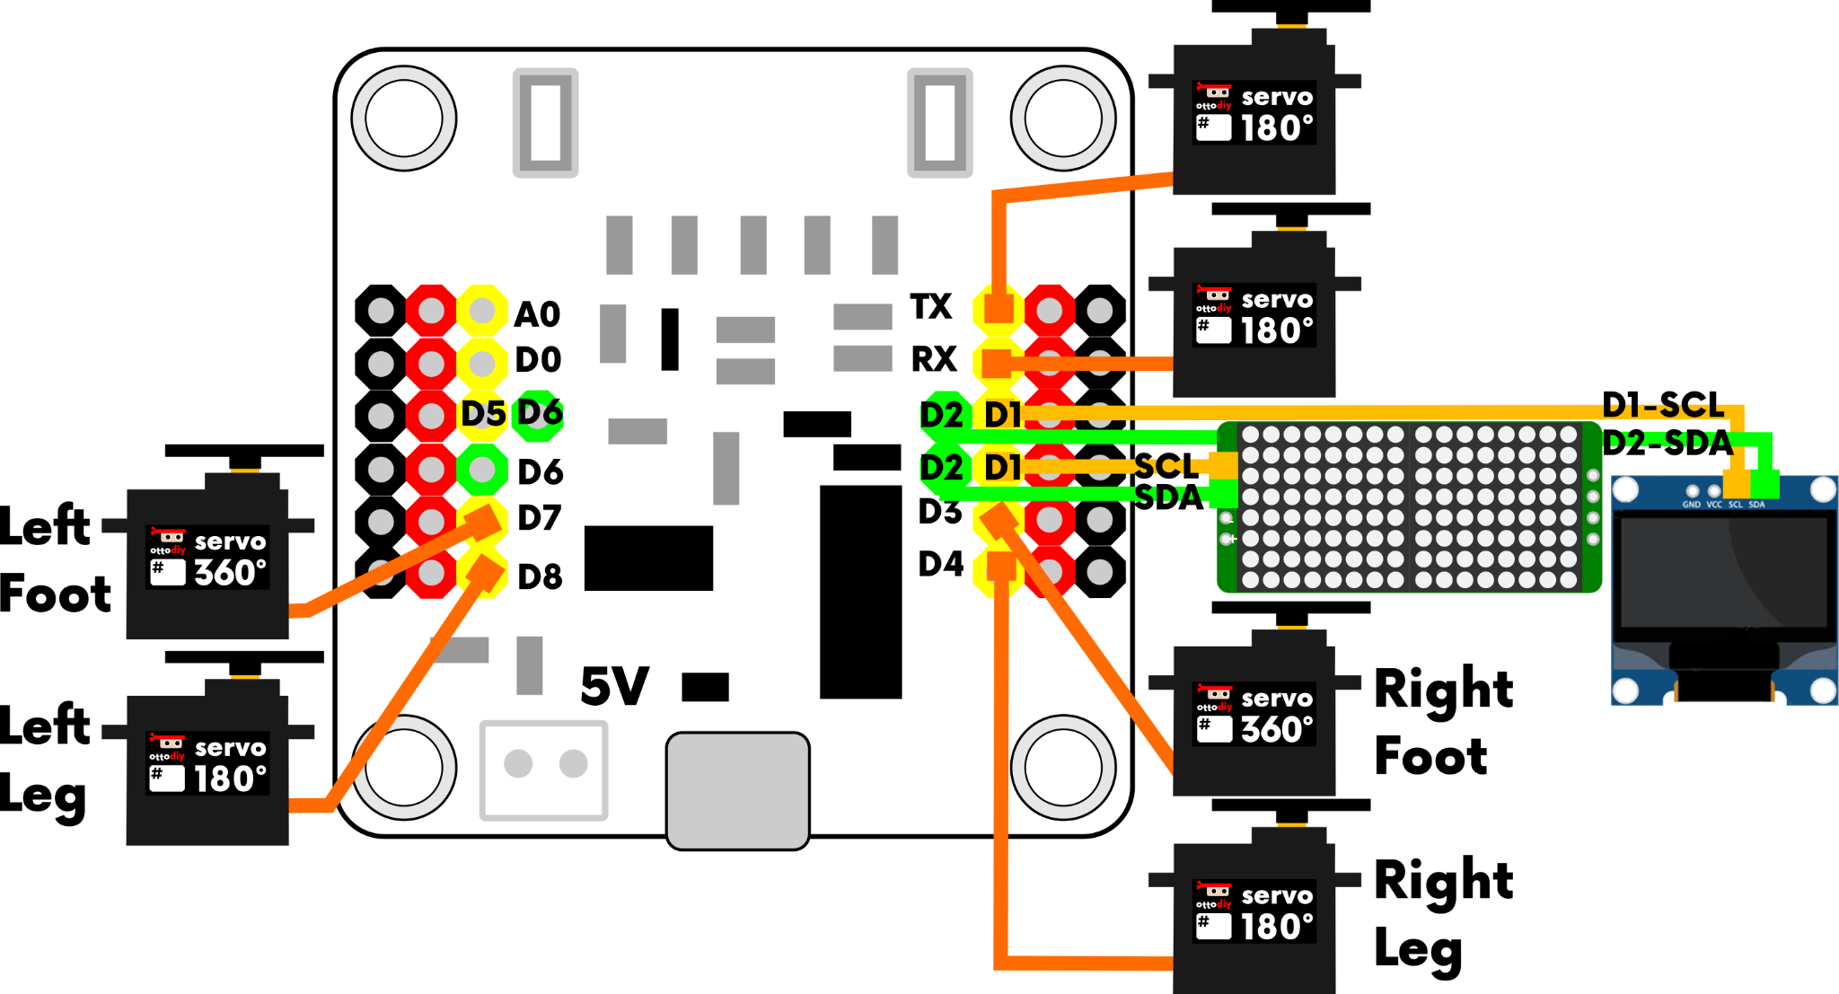
Wiring for Humanoid
Like with starter, you can make multiple types of Ninjas depending on what you connect and how you arrange the parts.
In the I2C ports, you can connect the LED matrix and OLED display at the same time!

Slide 9
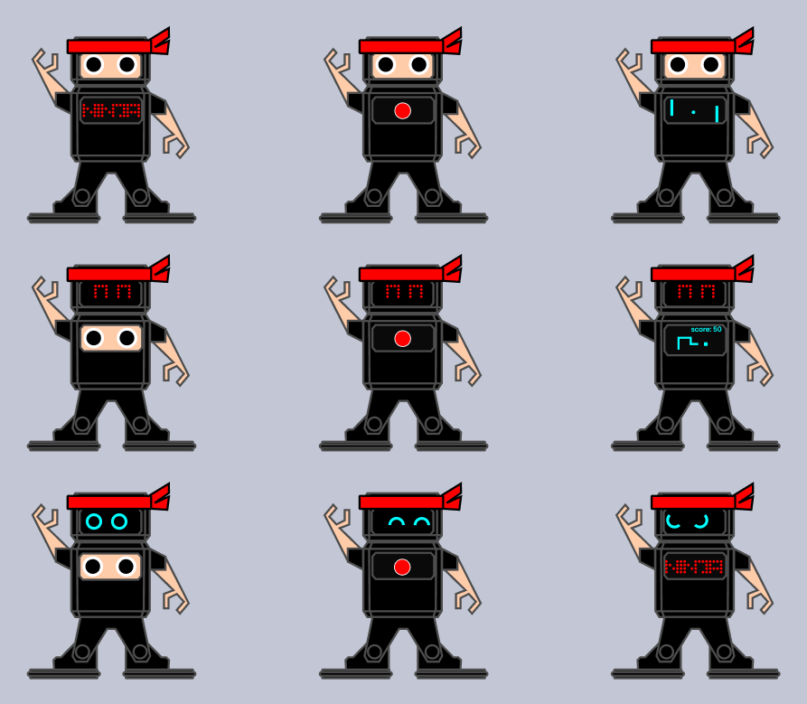
Possible combinations

Slide 10
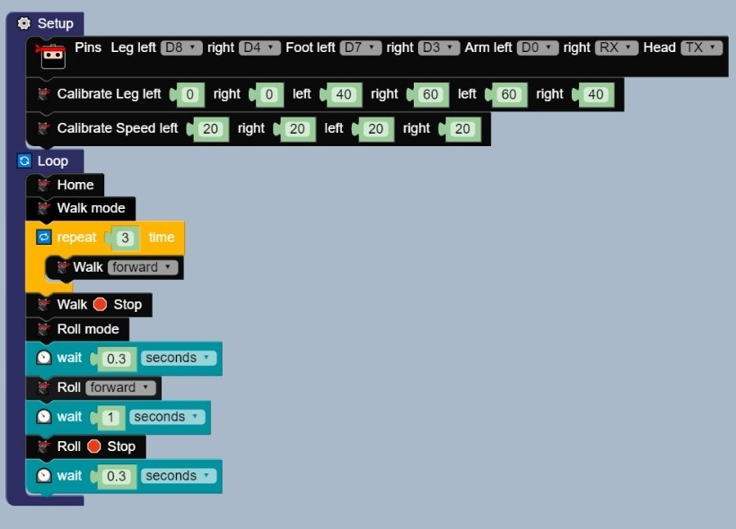
Simple
move
sequence

Slide 11
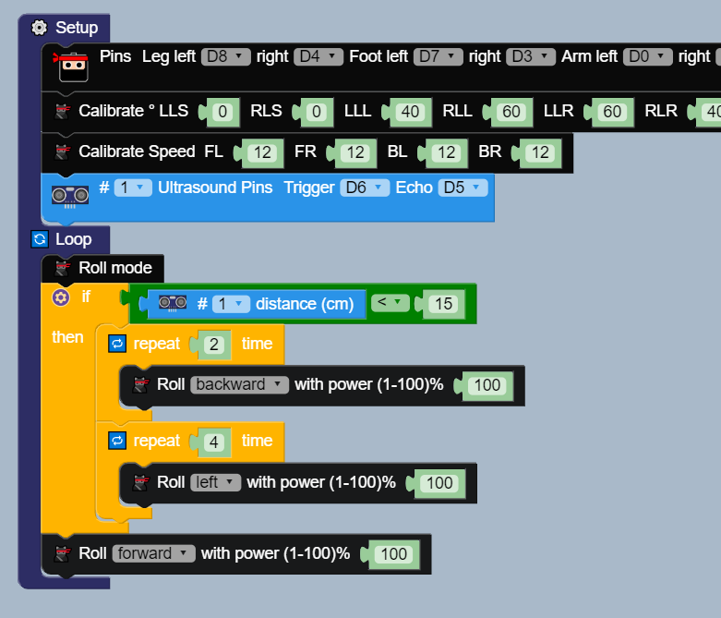
Avoid
Obstacles
Ultrasound
sensor

Slide 12
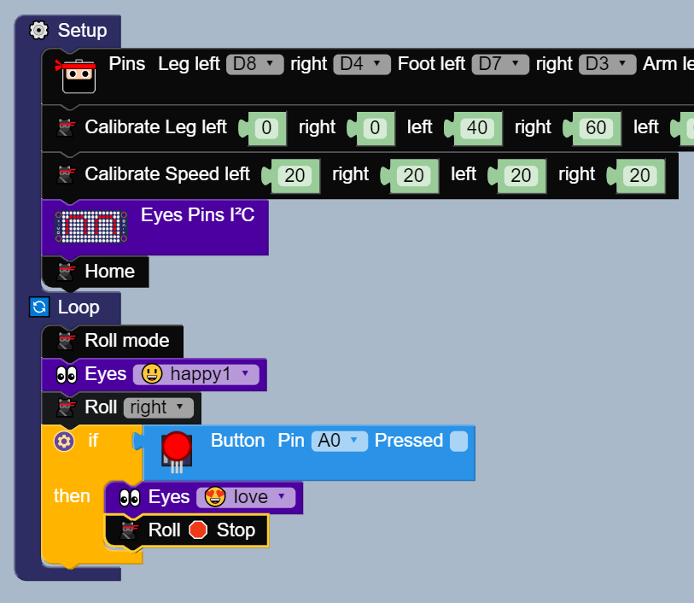
Button+
LED Matrix

Slide 13
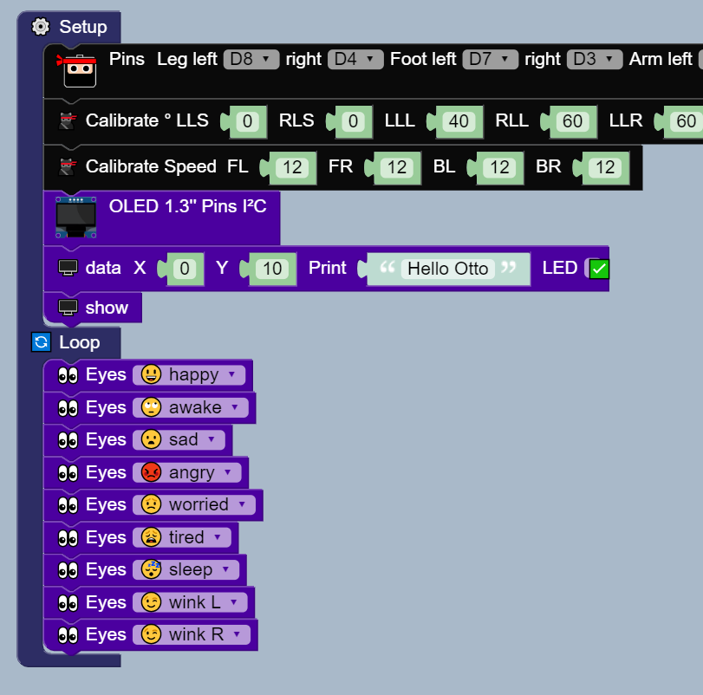
OLED
Display

Slide 14






IoT 🌐☁️ + 🐱‍👤
Internet of things

Slide 15
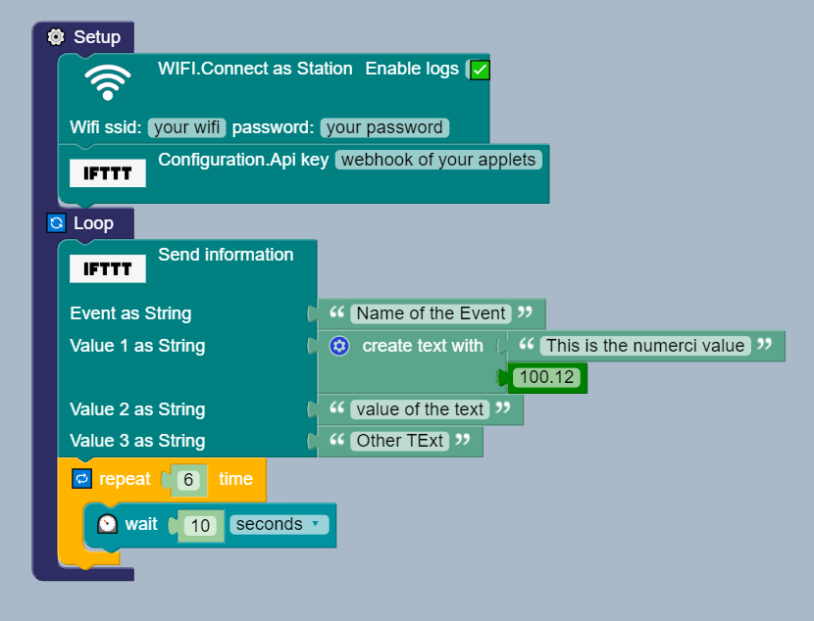
IFTTT
if
this
then
that
ninja!

Slide 16
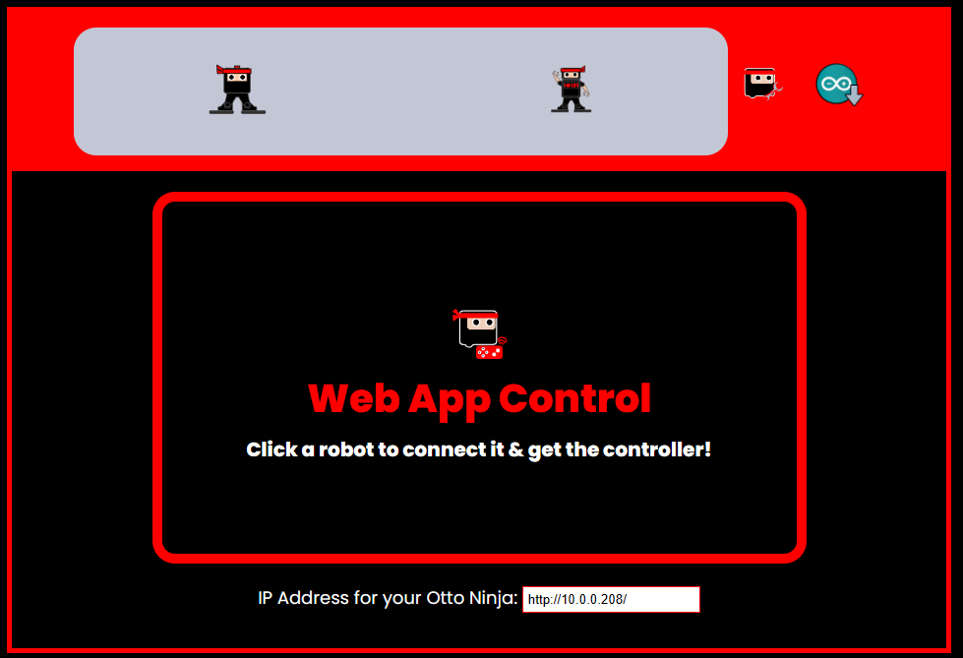
Web App
1. Download this code.
2. Modify Wifi settings according to your network.
3. Open serial monitor arduino at 115200 baudrate
4. Copy IP and paste in the web app box
5. Ready to play!
(Make sure to have Wi-Fi disconnected or auto connect to other networks) and power Ninja with battery all time.

Slide 17

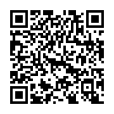

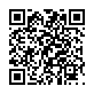
Mobile App (REMOTE XY)
1. Download & Install App on your mobile
2. In your phone Wi-Fi settings, connect to “OTTO NINJA”
3. Open the App Press + to add a new device
4. Select Wi-Fi point
5. Select "OTTO NINJA"
(Make sure to have Wi-Fi disconnected or auto connect to other networks) and power Ninja with battery all time.

Slide 18
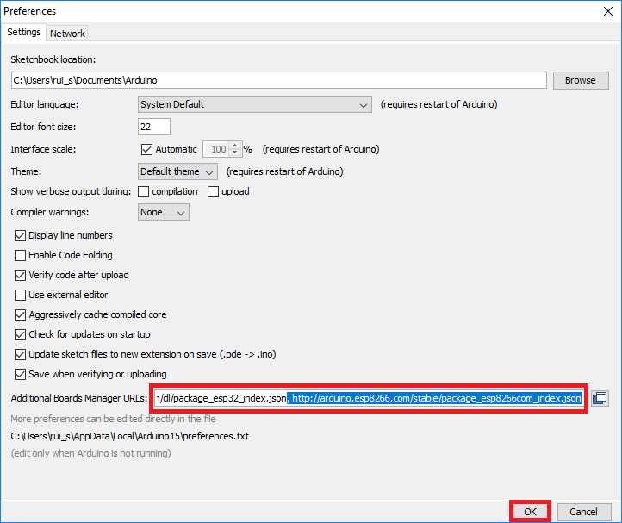
App code with Arduino
1. Install Arduino IDE
2. You will need to add the ESP8266 to your Arduino IDE, follow this video.
3. Download the .zip Otto Ninja libraries here.
4. Open Arduino IDE and navigate to Sketch > Include Library > Add .ZIP Library. At the top of the drop-down list, select the option to ¨Add .ZIP Library¨.

Slide 19
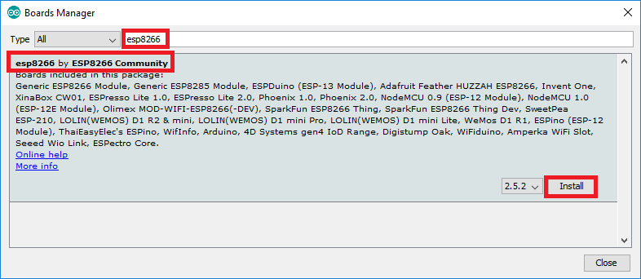
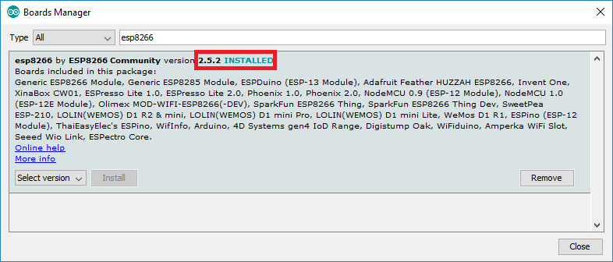
App code Arduino
5. Navigate to the .zip file's location, that you just downloaded and open it. In the main window, you will see in the bottom black area a message that it has been installed.
6. To verify they are properly installed, go to Sketch > Include Library menu. (You should now see the library by scrolling down at the bottom of the drop-down menu.)
7. In File > Examples > OttoNinja select OttoNinja_APP to open it.

Slide 20
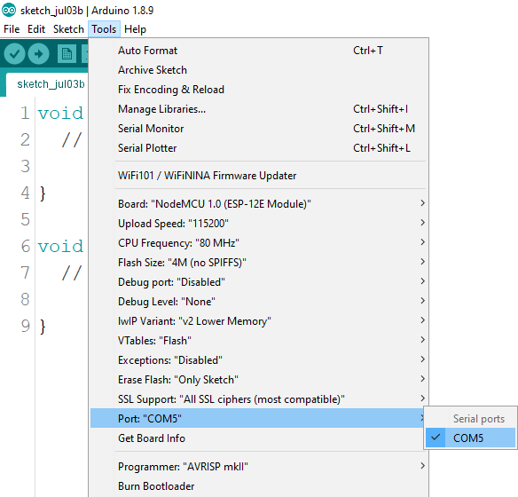
App code Arduino
8. Connect the Ninja board only with the USB to your computer, NO servos or anything else connected.
9. Make sure in Tools / Board "NodeMCU 1.0 (ESP-12E Module)" is selected.
10. Tools / Port select the COM# where your Ninja board is connected.
11. Click Upload

Slide 21
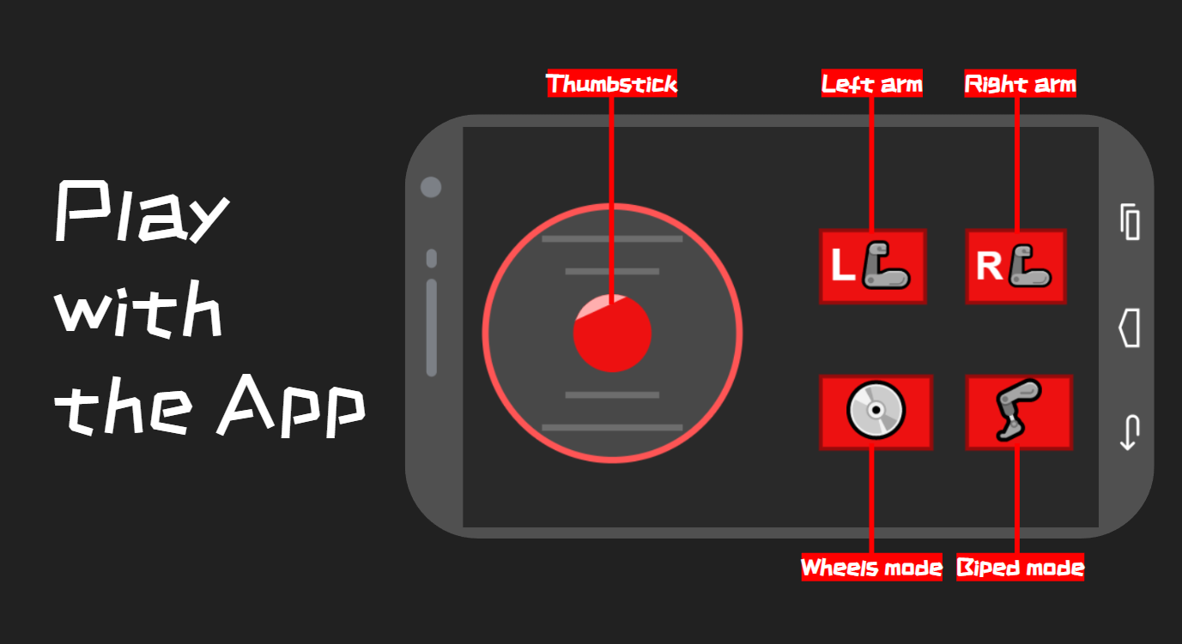

Slide 22
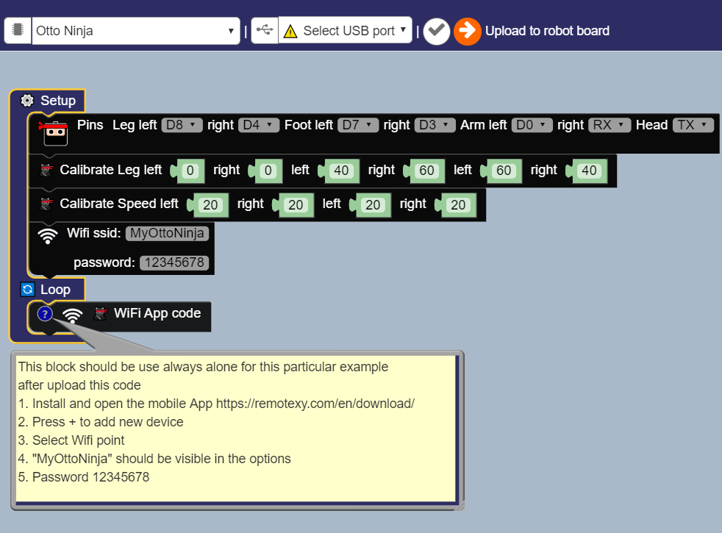
REMOTE XY app code
Alternatively upload the REMOTE XY App remote control code using Otto Blockly
(find this code in the examples)

Slide 23
find more
in the community
🐱‍👤
Join now!

Slide 24
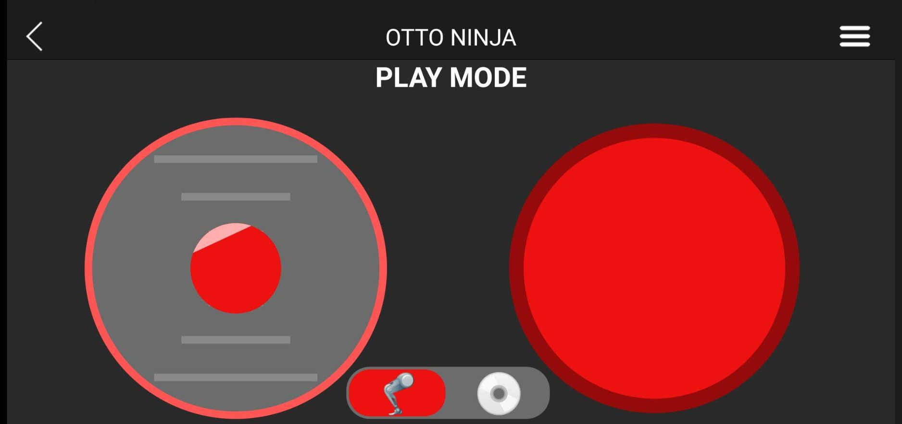
New Ninja App Beta
Thumbstick
Left arm
Biped mode
Wheel mode

Slide 25
Calibrate Ninja
Hold Left arm button for 5 seconds

Slide 26
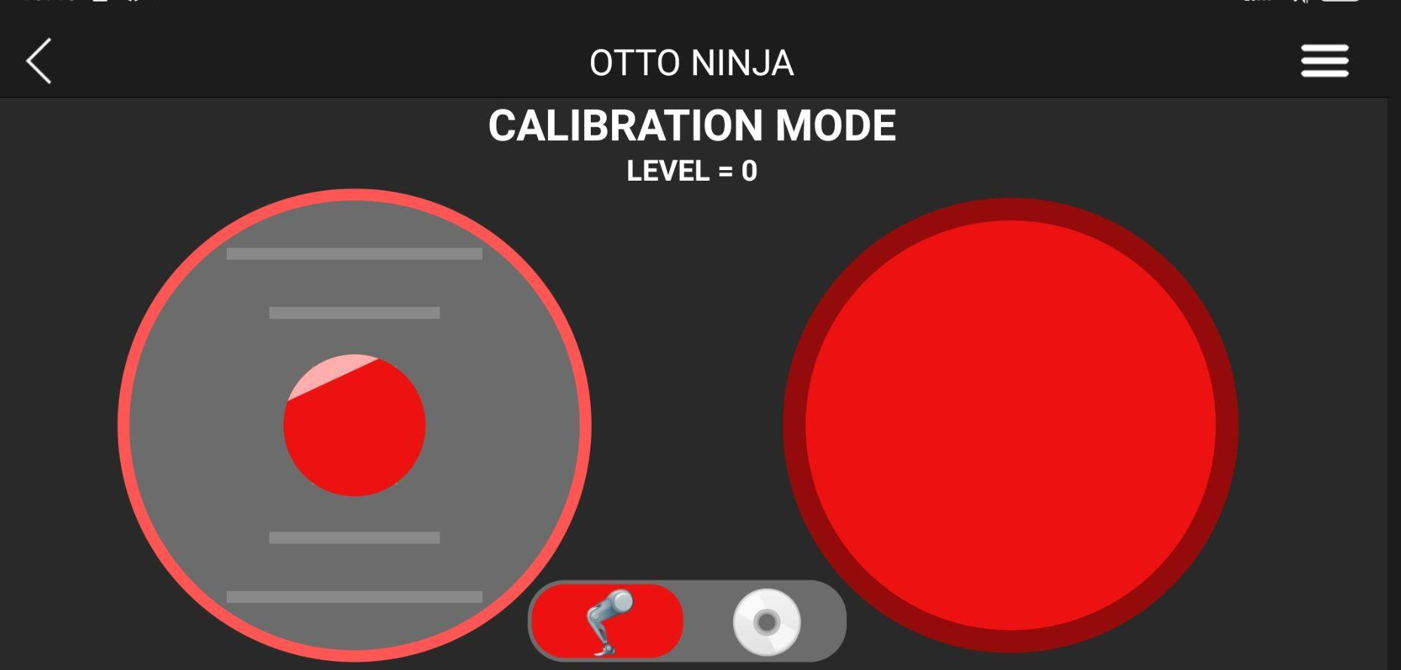
Scroll through calibration options
UP
DOWN

Slide 27
Adjust calibration settings in real time
LEFT
RIGHT

Slide 28
There are 6 different calibration options:
- Level
- Left foot forward speed
- Right foot forward speed
- Left foot backward speed
- Right foot backward speed
- Mode Starter/ Humanoid
- Save calibration

Slide 29
For
- Level
Adjust so that the robot is as level as possible in standing position.

Slide 30
For
- Left foot forward speed
- Right foot forward speed
- Left foot backward speed
- Right foot backward speed
Adjust so that the speed of each wheel motor is equal and slow.

Slide 31
For
- Mode Starter/ Humanoid
Select the mode that represents the Ninja robot you have built.

Slide 32
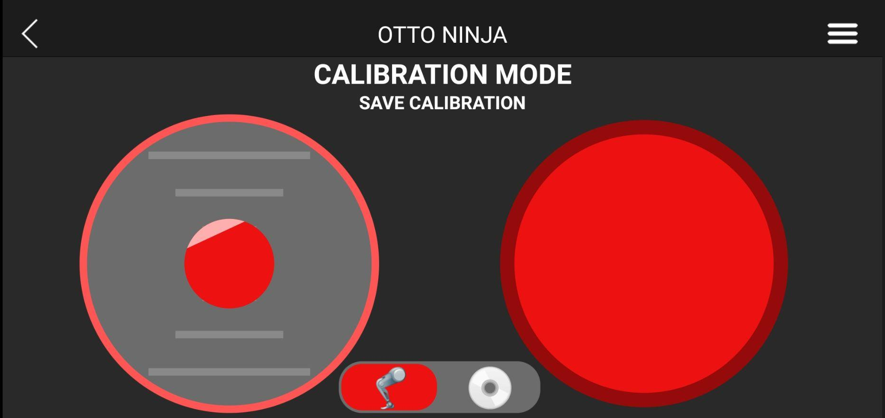
Return to play mode
Press to return to play mode on save calibration option

